Slide 1




Mixed Reality User Group
Remote aSSets in windows mixed reality
Joost van schaik
Developer++ @ Wortell
TWITTER #MIXUG003

Slide 2

Remote aSSets in windows mixed reality
Joost van Schaik
Wortell

Slide 3
What?
Loading (JSON) data from data services
Loading remote images
Preparing and loading remote audio
Preparing and loading remote video
Preparing and loading remote Holograms

Slide 4
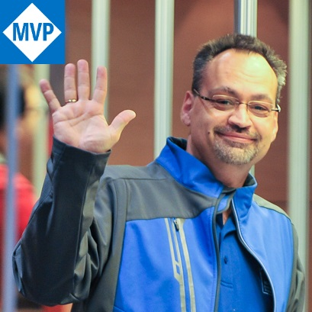
Who?
Joost van Schaik
Lead HoloLens / Business Apps developer @ Wortell
Microsoft Windows Development MVP
25 yr experience, 22 yr Geo-ICT
Developer++
Twitter, blog
Tinkerer, rogue R&D hacker
“Willie Wortel” (‘Gyro Gearloose’)

Slide 5

Where?
@localjoost
joostvanschaik@outlook.com
joost.van.schaik@wortell.nl
linkedin.com/in/joostvanschaik
dotnetbyexample.blogspot.com

Slide 6

Wortell?
Digital transformation
Work everywhere (Office365)
Always the bleeding edge
Cloud cloud cloud (did I mention cloud?)
Microsoft
Application development
Markets:
Care
Construction
Large infrastructural corporations (NS, Schiphol)

Slide 7



Slide 8
Why?
Dynamic content
Real time info
Subsets of large datasets
Content update without app update

Slide 9
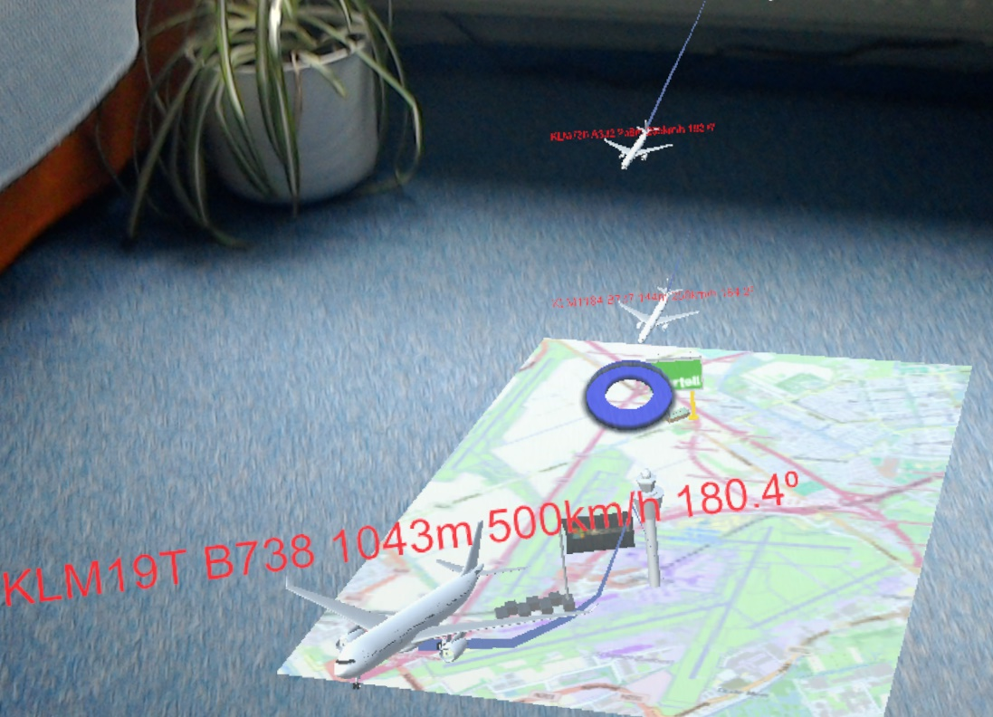
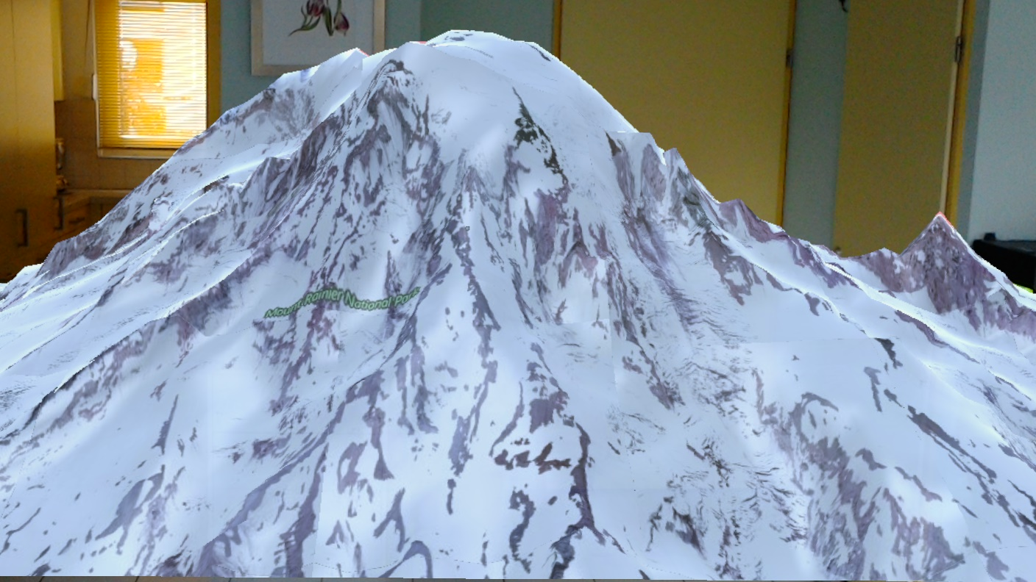
Examples

Slide 10
What again?
Loading (JSON) data from data services
Loading remote images
Preparing and loading remote audio
Preparing and loading remote video
Preparing and loading remote Holograms

Slide 11

Data services

Slide 12
DataServices
‘Ordinary’ JSON services downloading ‘some’ data
MR apps constructs 3D content based upon data

Slide 13
3 methods
WWW (deprecated)
UnityWebRequest
Pure UWP (HttpClient/HttpRequestMessage)

Slide 14
UnityWebRequest
Uses handlers
Integrates with Unity, easy conversion JSON->Data objects
Works in editor (easier testing)

Slide 15
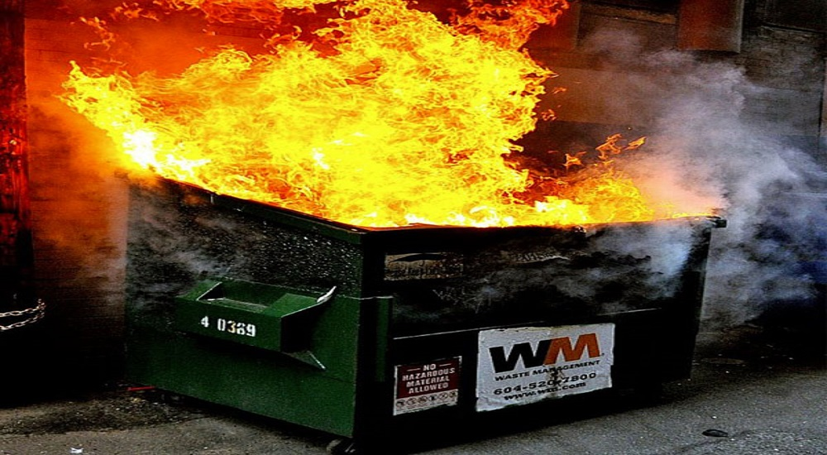
Demo – Data SErvices

Slide 16
Recap
UnityWebRequest
ZUMO-API-VERSION", "2.0.0”
request.downloadHandler.text -> default handler
JsonConvert.DeserializeObject (!!)

Slide 17
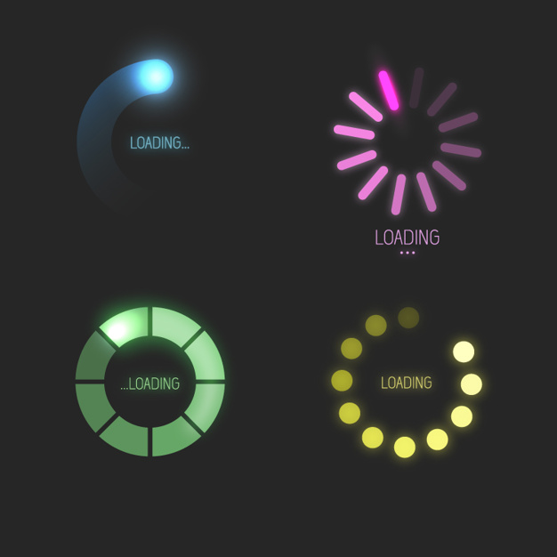
Loading Images

Slide 18
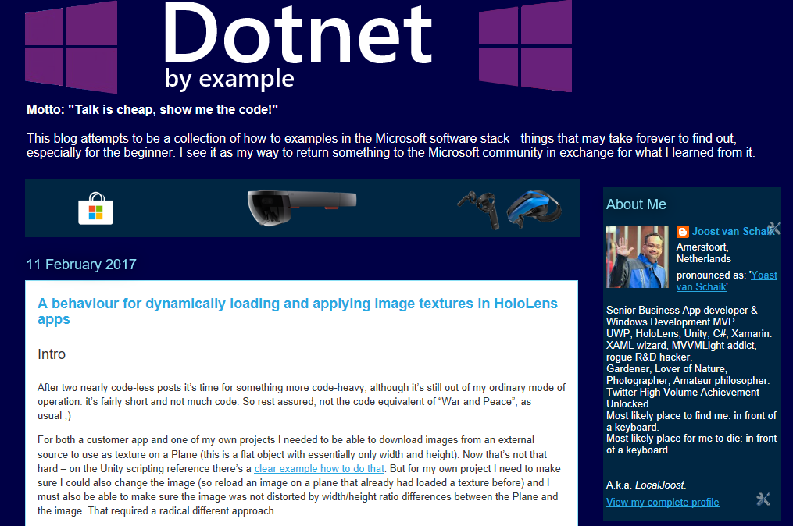
Nope!

Slide 19
Downloading images:
Use a plane
Rotate plane 90°/90°/270°
Download the image
Set plane renderer’s texture material to downloaded image

Slide 20
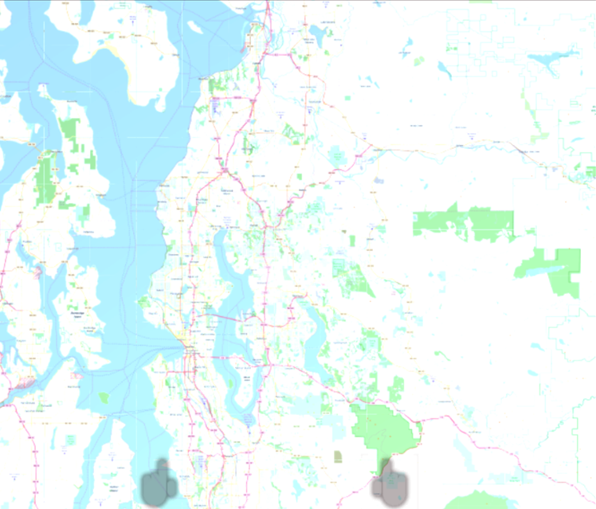
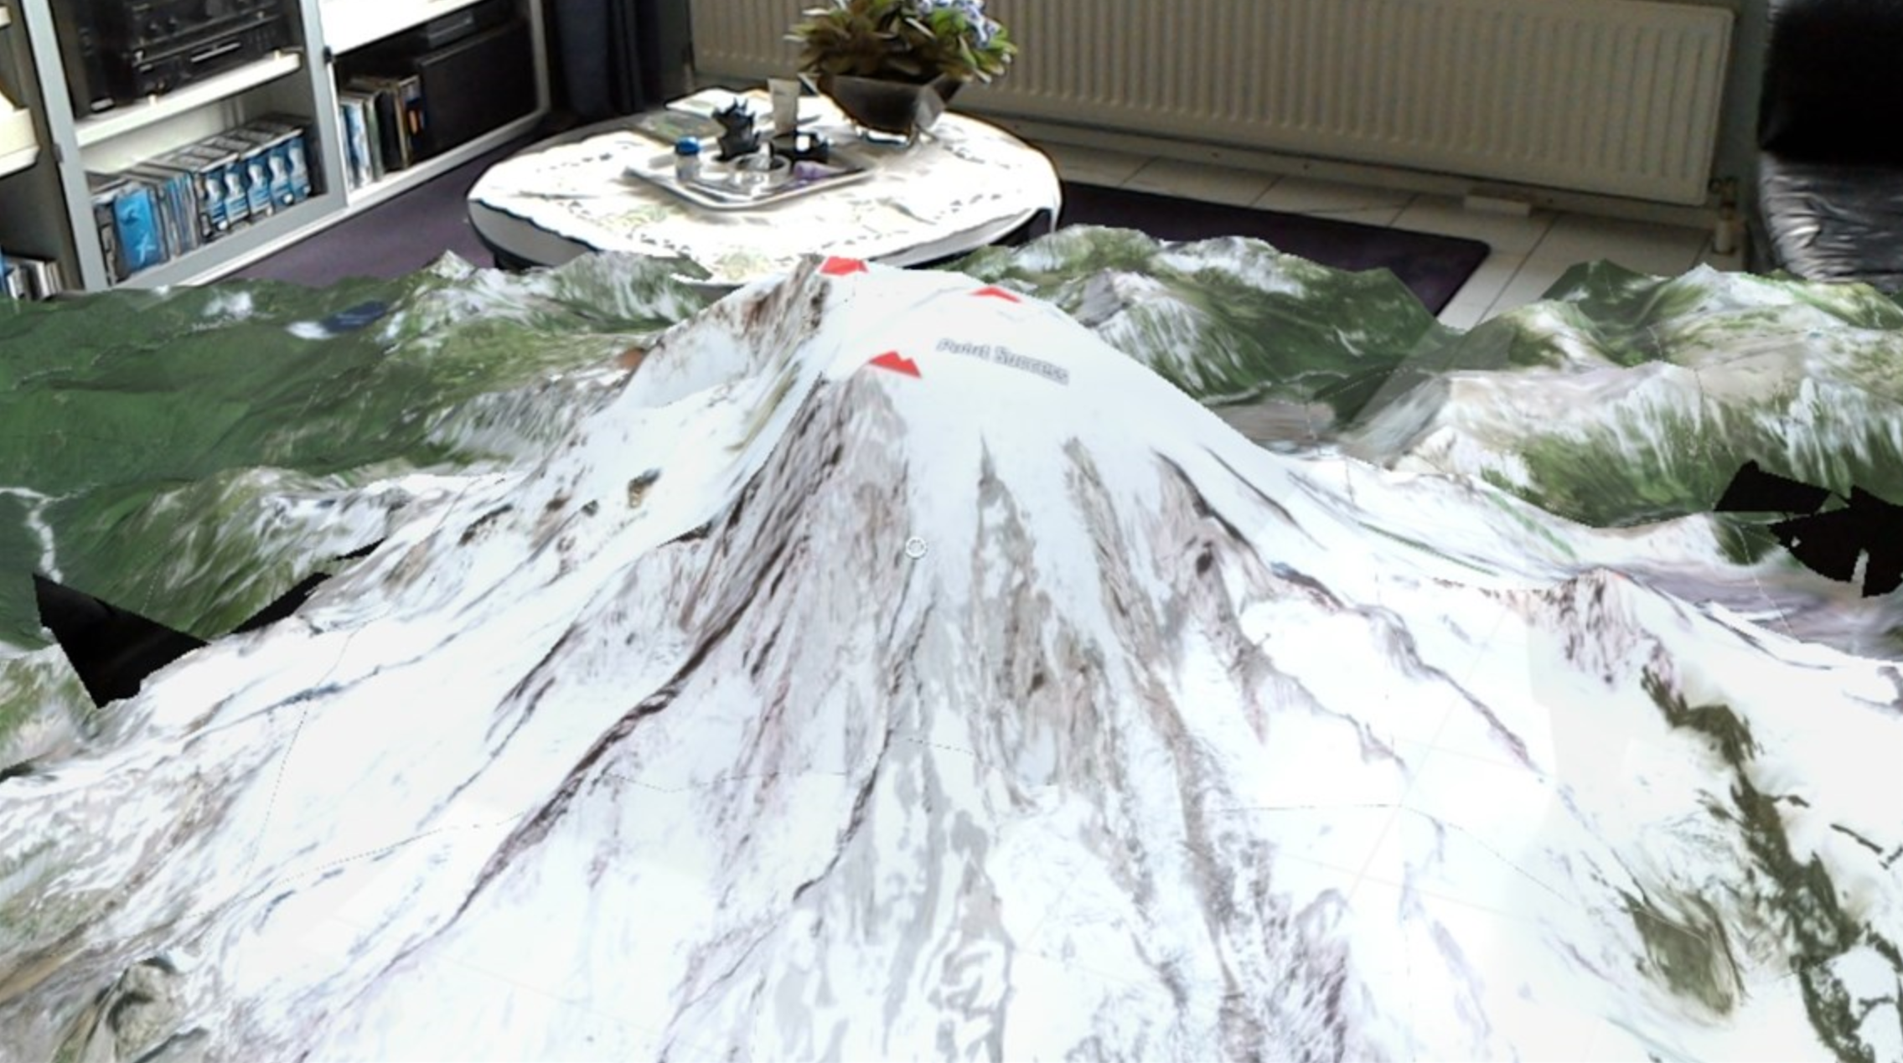

Slide 21

AUDIO FILES

Slide 22
Tools
Audacity
convert to .ogg
Azure portal
Create Storage Account
Microsoft Azure Storage Explorer
Create Blob container
Upload .ogg to blob
Get shared access signature url

Slide 23
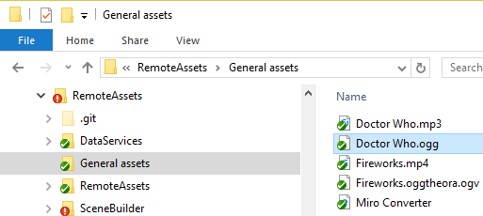
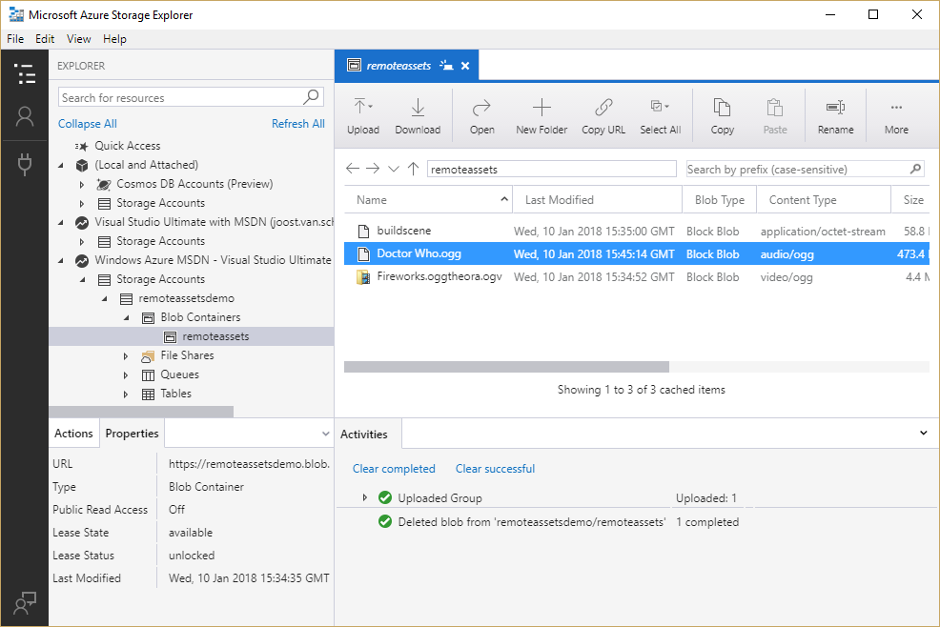
Upload

Slide 24
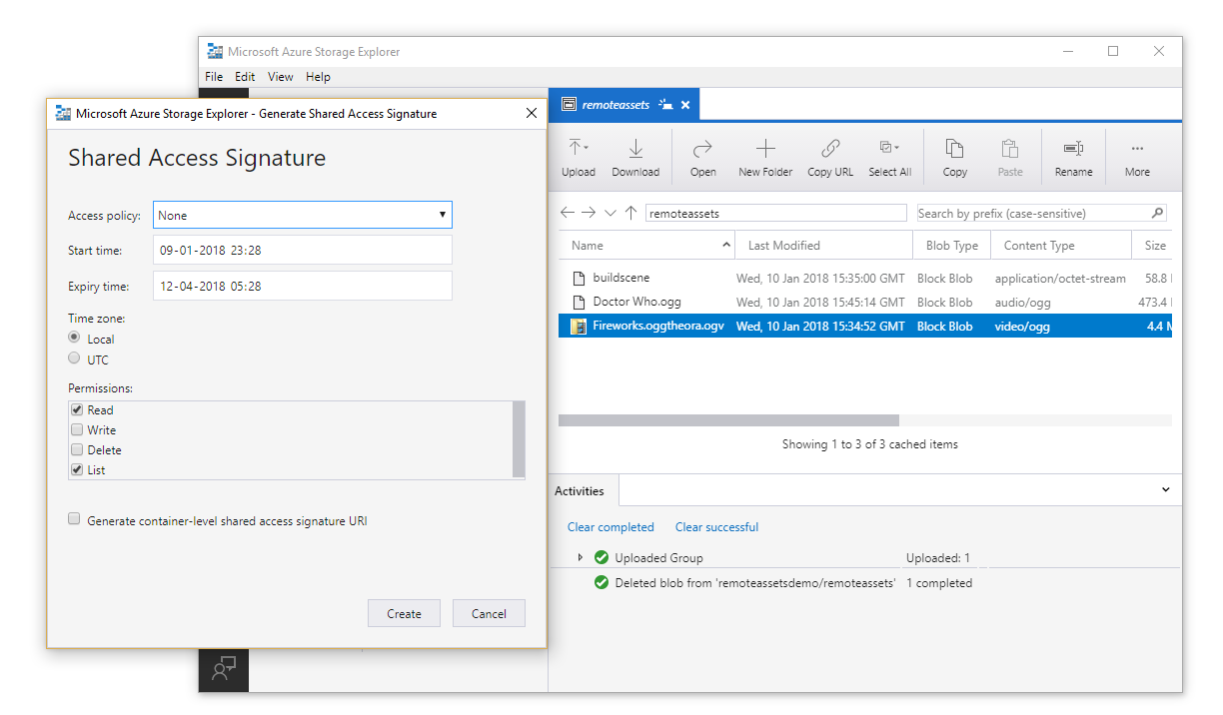
Shared Access Signature

Slide 25
Global approach
Use UnityWebRequest
Use DownloadHandlerAudioClip
AudioSource.clip = handler.audioClip

Slide 26

Demo – Audio clip
(with controls)

Slide 27
Recap
Use UnityWebRequest
Use DownloadHandlerAudioClip -> AudioType.OGGVORBIS
AudioSource.clip = handler.audioClip
AudioSource.clip.length
AudioSource.Play, Pause, Stop
Floating button and slider from MRTK-examples
IconToggler

Slide 28

VIDEO

Slide 29
Tools
FFmpeg (https://ffmpeg.zeranoe.com/builds/)
convert to oggtheora (.ogv)
Azure portal
Create Storage Account
Microsoft Azure Storage Explorer
Create Blob container
Upload ogv to blob
Get shared access signature url

Slide 30
Global approach
Use a plane
Rotate plane 90°/90°/270°
Use UnityWebRequest
Use DownloadHandlerMovieTexture Set plane renderer’s texture material to downloaded movie texture
AudioSource.clip to movie texture audio clip

Slide 31
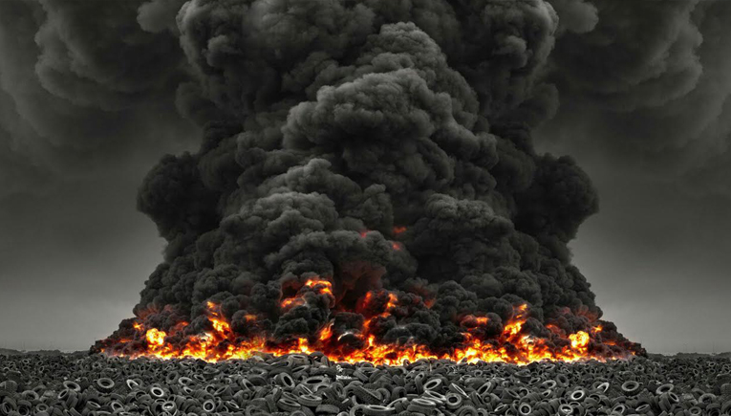
Demo – Video with Audio
(And look-at-controlling)

Slide 32
Recap
UnityWebRequest
DownloadHandlerMovieTexture GetComponent<Renderer>().material.mainTexture = handler.movieTexture
AudioSource.clip = handler.movieTexture.audioClip
movieTexture.Play, Pause – no stop, no time setting
Play by looking, pause by not looking (after timeout)
Consider size/quality

Slide 33
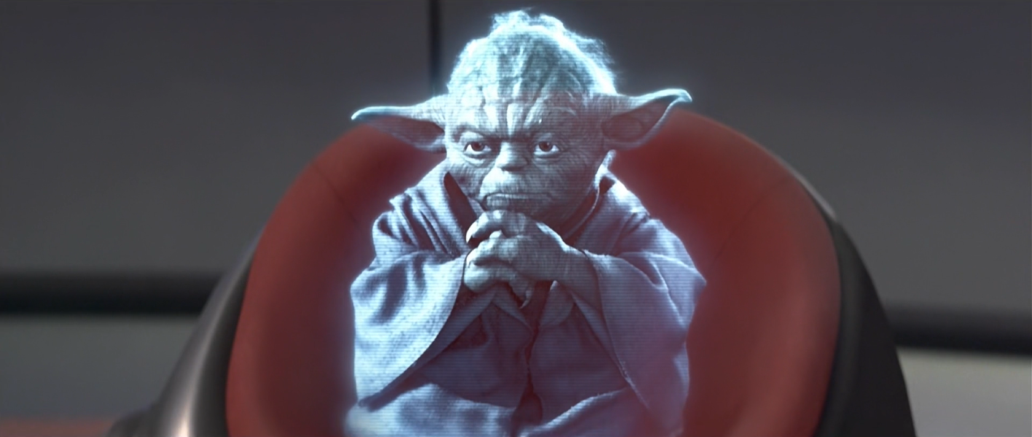
REMOTE HOLOGRAMS

Slide 34
Global approach
Build an “Asset Bundle” of a scene (or something else)
Upload to Azure blob
Download scene or other asset
Process

Slide 35
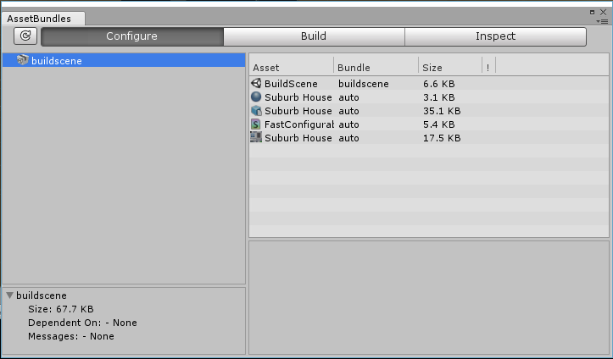
Building an Asset Bundle (1)
AssetBundle Browser
https://github.com/Unity-Technologies/AssetBundles-Browser
Window/AssetBundle Browser

Slide 36
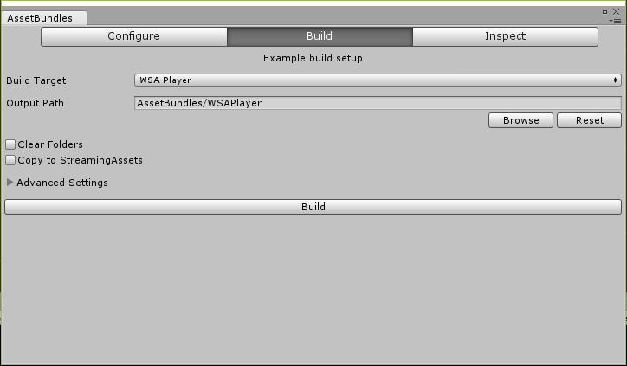
Building an Asset Bundle (2)
Empty scene, only the stuff you want
BUILD THE APP FIRST
Drag assets in Left tab
Check Build tab
Select “WSA Player”
Hit the big Build button

Slide 37
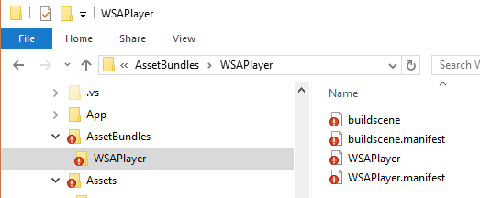
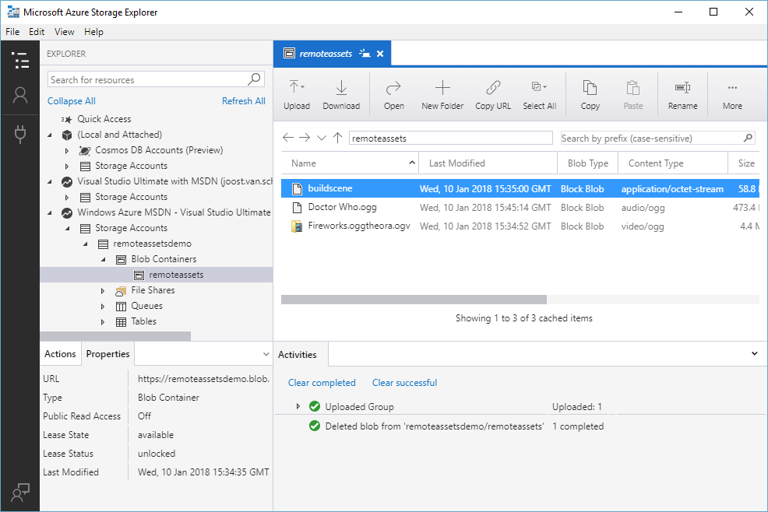
Upload to Azure, SAS

Slide 38
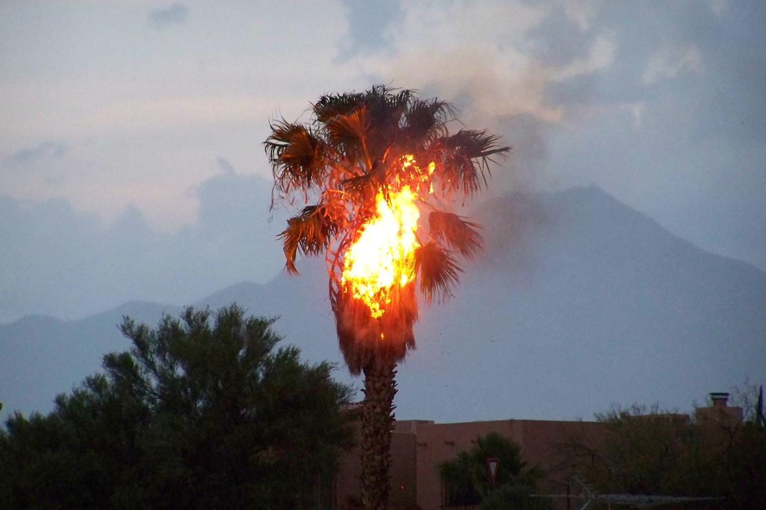
Demo – Building/Uploading Unity Assets

Slide 39
Recap
Sparse scene
Build app
Window/AssetBundle Browser
Select WSA Player
Build
Upload asset bundle to Azure
SAS

Slide 40
USING an Asset Bundle
UnityWebRequest
DownloadHandlerAssetBundle
DownloadHandlerAssetBundle.GetAllScenePaths()
SceneManager.LoadSceneAsync() - > Additive

Slide 41

Demo – DoWnloading/showing Unity Assets

Slide 42
Recap
DownloadHandlerAssetBundle
SceneManager.LoadSceneAsync
Fishing loaded stuff from additive scene
or
bundle.LoadAsset<T>
Instatiate prefab

Slide 43
Stuff you can put in Asset Bundles
Scenes
Audio
Video
Prefabs
Materials
Shaders
Text files
Basically any asset – but NO SCRIPTS

Slide 44
Thoughts/warnings
Any code referenced MUST BE IN TARGET PROJECT
Beware of version issues
ALWAYS ALWAYS TEST
Still need to prepare the models in Unity
Local caching

Slide 45


Slide 46

The END

Slide 47
INNOVATE TO LEAD

Slide 48
Who again?
@localjoost
joostvanschaik@outlook.com
joost.van.schaik@wortell.nl
linkedin.com/in/joostvanschaik
dotnetbyexample.blogspot.com

